Slide 1
Database Management Systems DIET AND WORKOUT ASSISTANT

Slide 2
TEAM OF
G.Haritha Maithreyee(2110030014)
G.Mahitha Christina(2110030147)
A.Bhavya Sri(2110030067)
G.Vaishnavi(2110030009)
Under the guidance of
MR .SUMIT HAZRA

Slide 3
TOOLS SETUP
In this project as a part of DBMS, We need to access data using queries.
DBMS is completely back end software that is used to retrieve or update data.
That is we use MySQL software for queries.

Slide 4
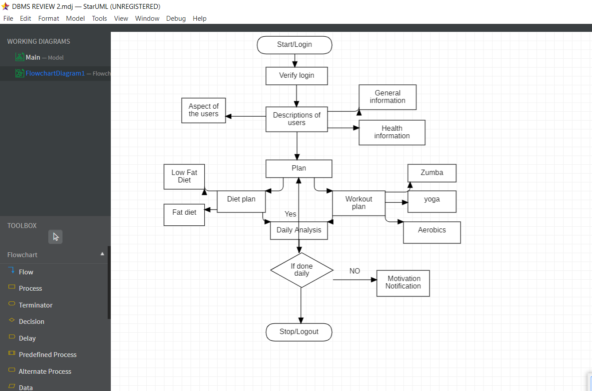
FLOW CHART

Slide 5
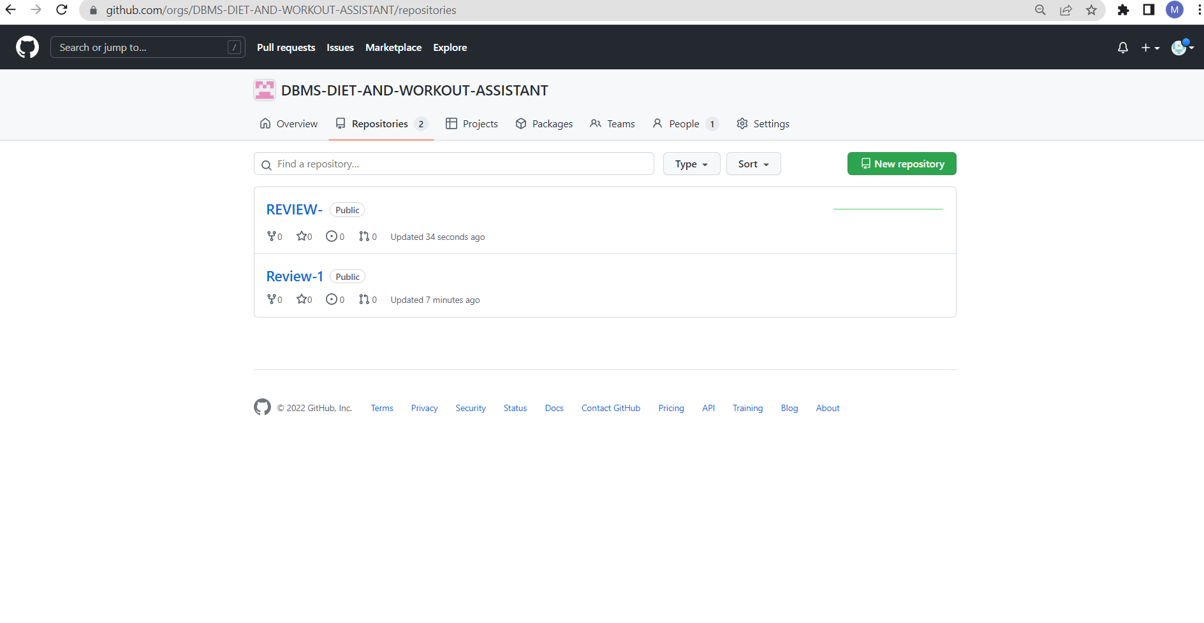
GITUP COMMITS

Slide 6
Work progress
To implement the project we need to undergo five phases: Communication, Planning, Modelling, Construction, Deployment.
We completed modelling phase and proceeding to construction phase.

Slide 7
THANK YOU

